Slide 1
Category review: Chips
June 2020
Retail Analytics
Brand note: If client logo is not required, use alternate title page layout right click slide thumbnail > Layout > Title

Slide 2
Notes:
To view Privacy video explaining how important data privacy is to Quantium, please click here: https://www.youtube.com/watch?v=Zq1QDAkoRzU
or here Q:\Company Reference\Brand & Design\Brand videos\Q Privacy.mp4
At Quantium, we believe that data is the behavioural footprint of humanity and that it has to be treated with the utmost care and responsibility.
Histories, attitudes, indeed lives are stored within it in ways that aren’t always apparent – and that’s what makes its potential so powerful.
To work with it responsibly, sensitively, we set ourselves the highest data privacy protection and governance standards.
We have spent 17 years perfecting privacy-by-design and secure-by-design principles. Central to this is not holding any personally identifiable information about people –
we neither receive it, and put the necessary protections in place to be unable to decipher it.
Every aspect of handling data is safeguarded: from its de-identification, to its encryption – data security is paramount and of the highest grade.
We pride ourselves on gaining the trust of iconic organisations around the world through years of securely working with their data,
and in turn the trust that builds with their stakeholders.

Slide 3
Executive summary
01
Task 1
After the analysis some insights were found that could be communicated to the category manager for informed decision on the nature of chips sales in the region. these includes the following:
It is seen that Sales have mainly been due to Budget - older families, Mainstream - young singles/couples (YSC), and Mainstream retirees shoppers.
We found that the high spend in chips for mainstream young singles/couples and retirees is due to there being more of them than other buyers.
Mainstream, midage and young singles and couples are also more likely to pay more per packet of chips.
02
Task 2
We’ve found control stores 233, 155, 237 for trial stores 77, 86 and 88 respectively. The results for trial stores 77 and 88 during the trial period show a significant difference in at least two of the three trial months but this is not the case for trial store 86 but overall, the trial shows a significant increase in sales.

Slide 4
01
Category

Slide 5
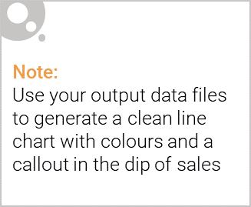
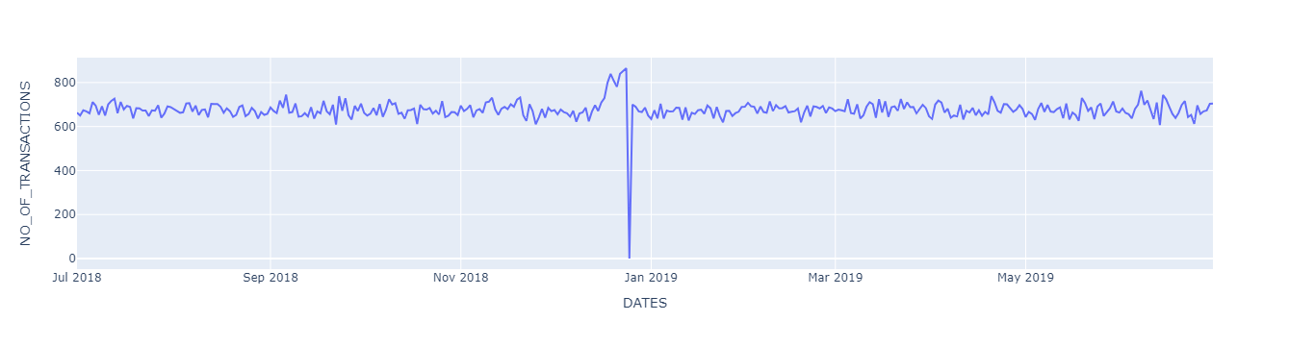
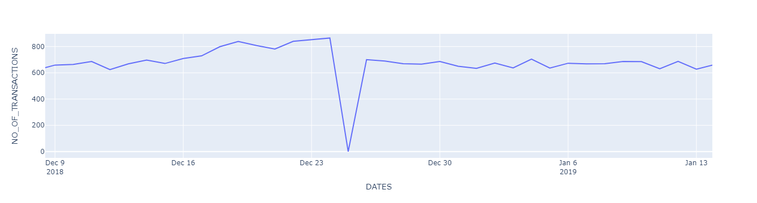
Overview: From Visualization, we can see that sales increase while approaching the 25th of Dec and then decline on the 25th (due to non-operational holiday) and revert back to the normal sales after the 25th...

Slide 6

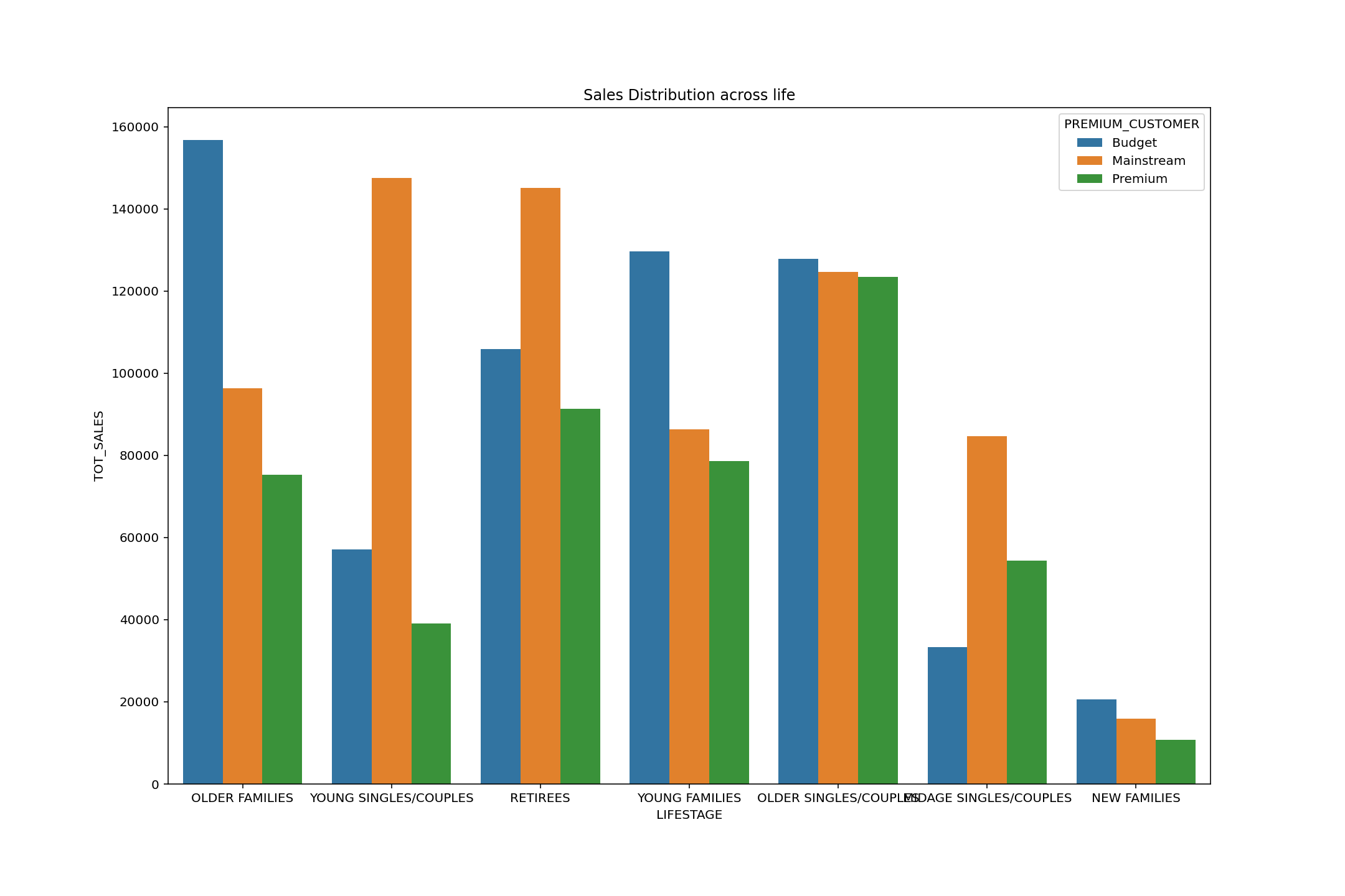
From this visuals we can see that the budget older families followed by the mainstream young single couples have the highest total sales, which means that affluence doesn’t seem to affect their purchasing power

Slide 7
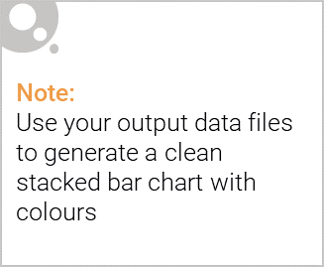
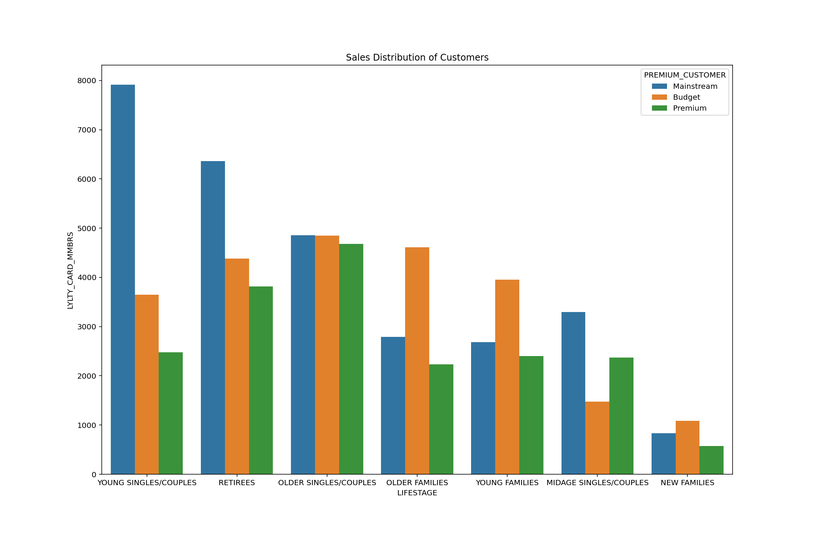
Editable (delete this)
Even though the budget older families have the highest total sales, we can see that it is not as a result of having the highest members in this life stage group. Mainstream Young single couples seem to have the highest members with 0ver 7k members and retirees with over 6k members

Slide 8
02
Trial store performance

Slide 9
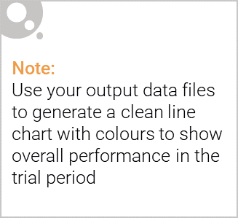
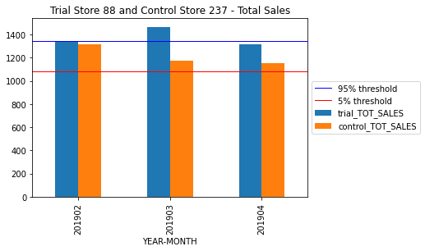
Control vs Other stores

Slide 10
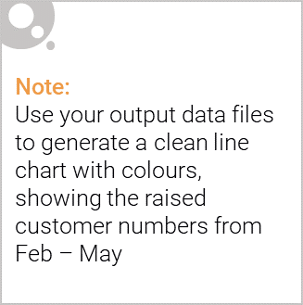
We can see that Trial store 77 sales for March and April exceeds 95% threshold of control store. Same goes to store 86 & 88 sales for March.
In conclusion We’ve found control stores 233, 155, 237 for trial stores 77, 86 and 88 respectively. The results for trial stores 77 and 88 during the trial period show a significant difference in at least two of the three trial months but this is not the case for trial store 86.

